Slide 1
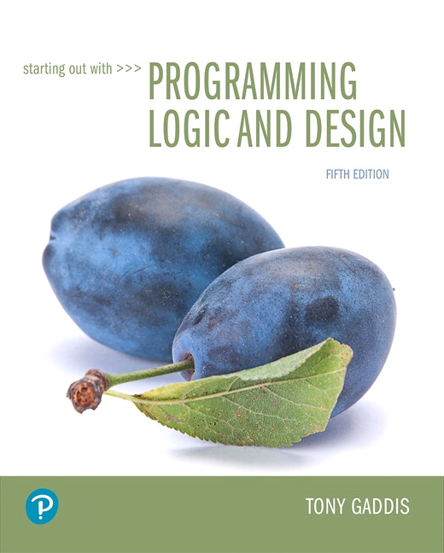
Starting out with Programming Logic and Design
Fifth Edition
Chapter 1
Introduction to Computers and Programming
Copyright © 2016, 2013, 2010 Pearson Education, Inc. All Rights Reserved
Notes:
If this PowerPoint presentation contains mathematical equations, you may need to check that your computer has the following installed:
1) MathType Plugin
2) Math Player (free versions available)
3) NVDA Reader (free versions available)

Slide 2
1.1 Introduction (1 of 4)
People use computers at…
School for writing papers, research, email, online classes, etc.
Work for analyzing data, make presentations, business transactions, communicating, control machines, etc.
Home for paying bills, shopping online, communicating, playing computer games, etc.
What are some of the ways you use computers?

Slide 3
1.1 Introduction (2 of 4)
Devices that are computers…
SmartPhones
MP3 Players
Tablets
Car navigation system (G P S)
Can you think of some other devices that are computers?

Slide 4
1.1 Introduction (3 of 4)
Computers are designed to do any job that their programs tell them to do.
A program is a set of instructions that a computer follows to perform a task.
For example: Microsoft Word and PowerPoint
Programs are commonly referred to as software.
What software have you used?

Slide 5
1.1 Introduction (4 of 4)
Programmers or Software Developers are the individuals that create computer software.
They have the training and skill to design, create, and test computer programs.
What are some of the fields in which computer programs are used?

Slide 6
1.2 Hardware and Software (1 of 18)
Concept:
The physical devices that a computer is made of are referred to as the computer’s hardware. The programs that run on a computer are referred to as software.

Slide 7
1.2 Hardware and Software (2 of 18)
Hardware
The physical devices that a computer is made of are referred to as the computer’s hardware.
A computer is a system of devices that work together.

Slide 8
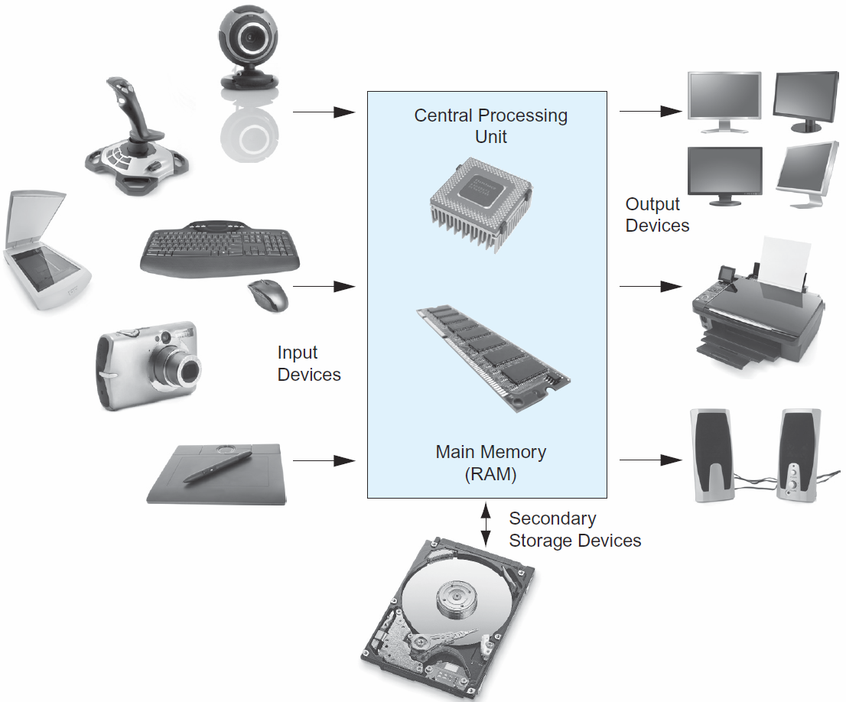
1.2 Hardware and Software (3 of 18)
Hardware
A Computer System consists of:
Central Processing Unit (C P U)
Main memory
Secondary storage
Input devices
Output devices
Figure 1-2 Typical components of a computer system

Slide 9
1.2 Hardware and Software (4 of 18)
Hardware
Central Processing Unit (C P U)
The C P U is the part of a computer that runs the programs.
Often referred to as the processor.
Without a C P U, a computer cannot run software.
Running or executing a program is the term used when the computer performs the tasks that the program tells it to do.

Slide 10
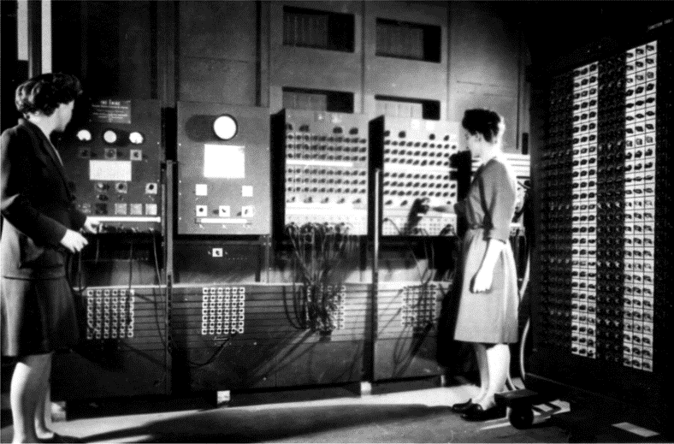
1.2 Hardware and Software (5 of 18)
Hardware
E N I A C
World’s first programmable computer
Built in 1945
Designed to calculate artillery ballistic tables for the U.S. Army
C P U was 8 feet tall, 100 feet long, and weighed 30 tons
Figure 1-3 The E N I A C computer (courtesy of U.S. Army Historic Computer Images)

Slide 11

1.2 Hardware and Software (6 of 18)
Microprocessor
Much smaller
Much more powerful
Figure 1-4 A lab technician holds a modern microprocessor (photo courtesy of Intel Corporation)

Slide 12
1.2 Hardware and Software (7 of 18)
Main Memory
Considered the computer’s work area
Computer stores the program that is running as well as the data
Commonly known as the random-access memory (R A M)
Data is quickly accessed
R A M is a volatile type of memory
Used for temporary storage
R A M is erased when computer is turned off

Slide 13
1.2 Hardware and Software (8 of 18)
Read-Only Memory (R O M)
A computer can read the contents of R O M, but it cannot change its contents, or store additional data there.
R O M is nonvolatile. It does not lose its contents, even when the computer’s power is turned off.
R O M is typically used to store programs that are important for the system’s operation. For example, the computer’s startup program, which is executed each time the computer is started.

Slide 14
1.2 Hardware and Software (9 of 18)
Secondary Storage Devices
Type of memory that can hold data for long periods of time.
Programs and important data are stored in secondary storage
Disk drive is a common type of secondary storage
Data is stored by magnetically encoding it onto a circular disk
Most computers have an internal disk drive
Some have external disk drives; they are used to create backup copies

Slide 15
1.2 Hardware and Software (10 of 18)
Solid-State drives are becoming increasingly popular
Does not contain a disk. Instead, it stores data in solid-state memory
No moving parts
Operates faster than a traditional disk drive

Slide 16
1.2 Hardware and Software (11 of 18)
U S B drives are small devices that plug into the computer’s universal serial bus (U S B) port
It does not contain a disk
The data is stored on flash memory
Also known as memory sticks and flash drives
Inexpensive, reliable, and small

Slide 17
1.2 Hardware and Software (12 of 18)
Optical devices (C D or D V D)
Data is encoded as a series of pits on the disc’s surface
Uses laser to encode the data
Holds large amounts of data
Good medium for creating backups

Slide 18
1.2 Hardware and Software (13 of 18)
Cloud Storage
When you store data in the cloud, you are storing it on a remote server via the internet, or via a company’s private network.
You can access it from many different devices, and from any location where you have a network connection.
Can also be used to backup important data that is stored on a computer’s disk.

Slide 19
1.2 Hardware and Software (14 of 18)
Input Devices
Any data the computer collects from people and from other devices is called input.
The hardware component that collects the data is called an input device.
Common input devices are:
Keyboard
Mouse
Touch screen
Scanner
Microphone
Digital camera
Can you think of any other input devices?

Slide 20
1.2 Hardware and Software (15 of 18)
Ouput Devices
Any data the computer produces for people or for other devices is called output.
The hardware component that formats and presents the data is called an output device.
Common output devices are:
monitor
printer
Can you think of any other output devices?

Slide 21
1.2 Hardware and Software (16 of 18)
Software
Everything a computer does is controlled by software.
Two categories of software:
System software
Application software

Slide 22
1.2 Hardware and Software (17 of 18)
System Software
Programs that control and manage the basic operations of a computer are referred to as system software.
Includes the following types:
Operating System controls the internal operations of the computer’s hardware and manages all of the devices connected to the computer.
Utility Programs perform a specialized task that enhances the computer’s operation or safeguards data.
Software Developments Tools are programs that are used to create, modify, and test software.

Slide 23
1.2 Hardware and Software (18 of 18)
Application Software
Programs that people normally spend most of their time running on their computers performing everyday tasks are referred to as application software.
For example:
Word processing
Spreadsheet
Database
Presentation
Can you think of any other application software?

Slide 24
1.3 How Computers Store Data (1 of 9)
Concept:
All data that is stored in a computer is converted to sequences of 0s and 1s.

Slide 25
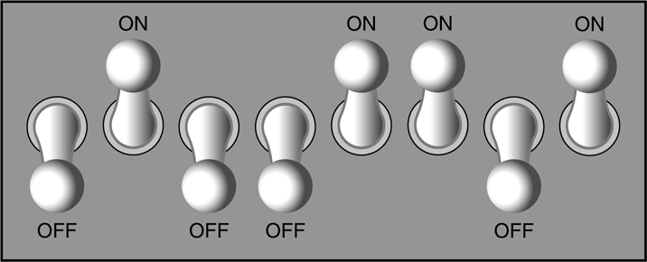
1.3 How Computers Store Data (2 of 9)
A computer’s memory is divided into tiny storage locations known as bytes
One byte represents one number
A byte is divided into eight smaller storage locations known as bits (binary digits)
Bits are tiny electrical components that can hold either a positive or a negative charge.
A positive charge is similar to a switch in the on position
A negative charge is similar to a switch in the off position
Figure 1-6 Think of a byte as eight switches

Slide 26
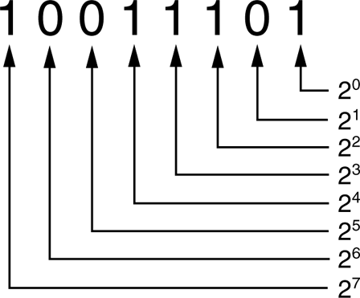
1.3 How Computers Store Data (3 of 9)
Storing Numbers
The positive charge or the on position is represented by the digit 1
The negative charge or the off position is represented by the digit 0
This corresponds to the binary numbering system where all numeric values are written as a sequence of 0s and 1s
Each digit in a binary number has a value assigned to it
Figure 1-8 The values of binary digits as powers of 2

Slide 27
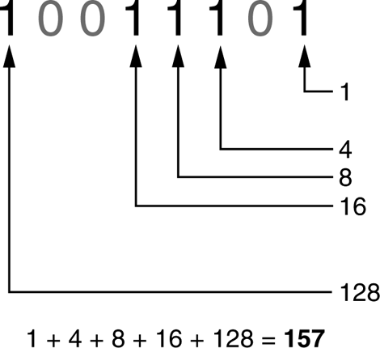
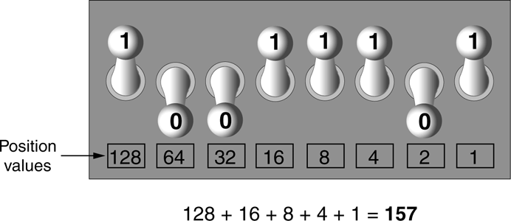
1.3 How Computers Store Data (4 of 9)
For example:
Figure 1-10 Determining the value of 10011101
Figure 1-11 The bit pattern for 157

Slide 28
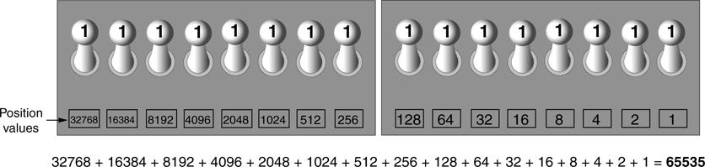
1.3 How Computers Store Data (5 of 9)
The largest value that can be stored in a byte with eight bits is 255
Two bytes are used for larger numbers; maximum value is 65535
Figure 1-12 Two bytes used for a large number

Slide 29
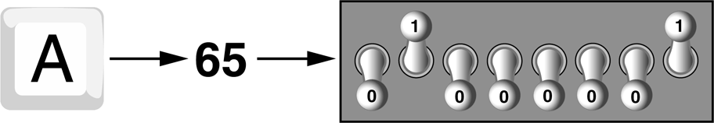
1.3 How Computers Store Data (6 of 9)
Storing Characters
Characters are stored in the computer’s memory as binary number
A S C I I (American Standard Code for Information Interchange) is a coding scheme
Figure 1-13 The letter A is stored in memory as the number 65

Slide 30
1.3 How Computers Store Data (7 of 9)
A S C I I is a set of 128 numeric codes
A S C I I is limited
Unicode is an extensive encoding scheme
It is compatible with A S C I I
It represents characters for many languages in the world

Slide 31
1.3 How Computers Store Data (8 of 9)
Advanced Number Storage
Binary numbering system can be used to represent only integer numbers
Negative numbers are encoded using two’s complement
Real numbers are encoded using floating-point notation

Slide 32
1.3 How Computers Store Data (9 of 9)
Other Types of Data
Digital data is data that is stored in binary
A digital device is any device that works with binary data
Digital images are composed of tiny dots of color known as pixels (picture elements)
Digital sound is broken into small pieces known as samples

Slide 33
1.4 How a Program Works (1 of 12)
Concept:
A computer’s C P U can only understand instructions that are written in machine language. Because people find it very difficult to write entire programs in machine language, other programming languages have been invented.

Slide 34
1.4 How a Program Works (2 of 12)
C P U is the most important component in a computer
C P U is not a brain
C P U is not smart
C P U is an electronic device that is designed to do specific things.

Slide 35
1.4 How a Program Works (3 of 12)
C P U is designed to perform the following operations:
Read a piece of data from main memory
Adding two numbers
Subtracting one number from another number
Multiplying two numbers
Dividing one number by another number
Moving a piece of data from one memory location to another
Determining whether one value is equal to another value

Slide 36
1.4 How a Program Works (4 of 12)
C P U only understands instructions written in machine language
Machine language instructions are written in 1s and 0s
The entire set of instructions that a C P U can execute is known as the C P U ’ s instruction set
Each brand of microprocessors (Intel, A M D, and Motorola) has a unique instruction set

Slide 37
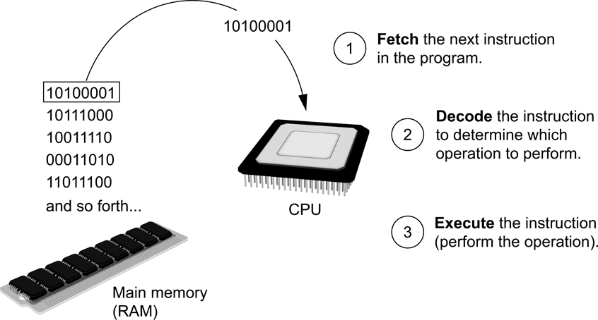
1.4 How a Program Works (5 of 12)
Fetch-decode-execute cycle is the term used when the C P U executes the instructions in a program.
The cycle consist of three steps:
Fetch
Decode
Execute
Figure 1-16 The fetch-decode-execute cycle

Slide 38
1.4 How a Program Works (6 of 12)
From Machine Language to Assembly Language
Computers only understand machine language
Machine language is difficult to write
Assembly language uses short words that are known as mnemonics
Assembler is used to translate an assembly language program to machine language

Slide 39
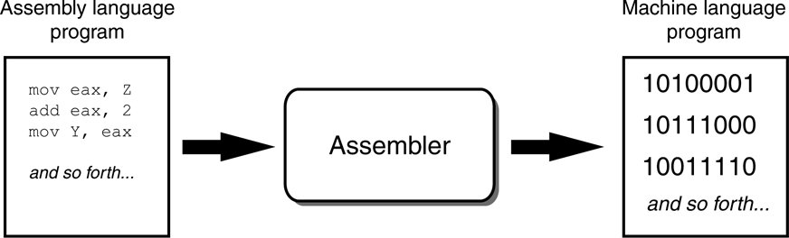
1.4 How a Program Works (7 of 12)
Figure 1-17 An assembler translates an assembly language program to a machine language program

Slide 40
1.4 How a Program Works (8 of 12)
High-Level Languages
Assembly language is referred to as a low-level language High-level languages allow you to create powerful and complex programs without knowing how the C P U works, using words that are easy to understand.
For example:
Java, C++, Python, Visual Basic,
, Ada, Fortran
Do you know of any other high-level computer programming languages?

Slide 41
1.4 How a Program Works (9 of 12)
Key Words, Operators, and Syntax: an Overview
Key words or reserved words have specific meaning and purpose in the programming language
Operators perform various operations on data
Syntax is a set of rules that must be strictly followed when writing a program
Statements are individual instructions written in a programming language

Slide 42
1.4 How a Program Works (10 of 12)
Compilers and Interpreters
The statements written in a high-level language are called source code or simply code
Source code is translated to machine language using a compiler or an interpreter
Syntax error is a mistake such as a:
Misspelled word
Missing punctuation character
Incorrect use of an operator

Slide 43
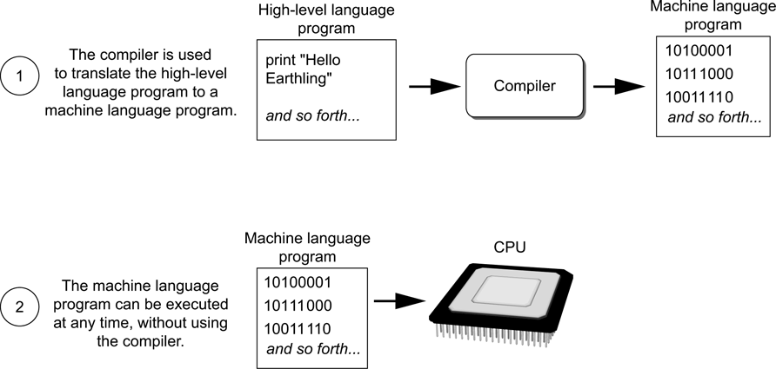
1.4 How a Program Works (11 of 12)
Compiler is a program that translates a high-level language program into a separate machine language program
Figure 1-18 Compiling a high-level program and executing it

Slide 44
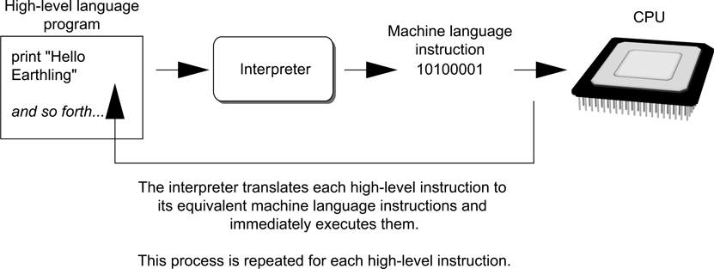
1.4 How a Program Works (12 of 12)
An interpreter is a program that both translates and executes the instructions in a high-level language program
Figure 1-19 Executing a high-level program with an interpreter

Slide 45
1.5 Types of Software
Programs generally fit into one of two categories
System software
The set of programs that control or enhance the operation of a computer such as an Operating System, Utility Programs, or Software Development Tools.
Application software
Programs that make a computer useful for every day tasks such as Microsoft Word, email programs, and Web browsers.

Slide 46

Copyright

